Slide 1
Operating Systems Security
Lesson Preview
Understand the important role an operating system plays in computer security
Learn about the need for hardware support for isolating OS from untrusted user/application code
Understand key trusted computing base concepts
Notes:
Headshot

Slide 2
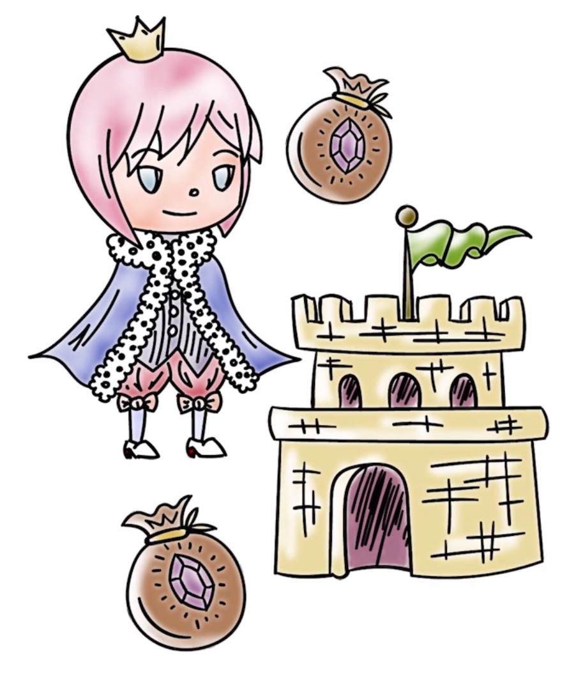
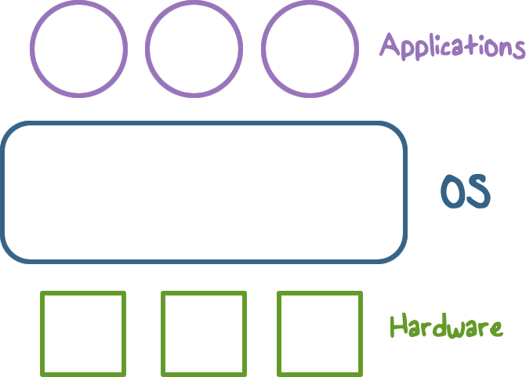
Operating Systems (OS)
Notes:
A Computer system is hardware/OS/user applications
An operating system is interacts with both the applications and the Hardware.

Slide 3

Operating Systems
Operating System:
Provides easier to use and high level abstractions for resources such as address space for memory and files for disk blocks.
Provides controlled access to hardware resources.
Provides isolation between different processes and between the processes running untrusted/application code and the trusted operating system.
Notes:
Operating system has direct access to hardware resources.
It provides easier to use and high level abstractions of these resources such as address space for memory and files for disk blocks.
Provides isolation between different processes and between the processes running untrusted/application code and the trusted operating system.

Slide 4

Need for Trusting an Operating System
Why do we need to trust the operating system?
(AKA a trusted computing base or TCB)
What requirements must it meet to be trusted?
TCB Requirements:
Tamper-proof,
Complete mediation, and
Correct
Notes:
Why do we need to trust the operating system (it is also called a trusted computing base or TCB)
TCB Requirements: (1) Complete mediation, (2) Tamper-proof, and (3) Correct

Slide 5

TCB and Resource Protection
TCB Controls access to protected resources
Must establish the source of a request for a resource (authentication is how we do it)
Authorization or access control
Mechanisms that allow various policies to be supported
Notes:
Controls access to protected resources
Must establish the source of a request for a resource (authentication is how we do it)
Authorization or access control
Mechanisms that allow various policies to be supported

Slide 6

Secure OS Quiz #1
A computer vendor ad claimed that its computers (including the OS they ran) were more secure. This claim could be based on one or more of the following:
This vendor’s more secure OS met TCB requirements while the others did not.
The two OS were similar as far as security was concerned but one was not as big a target.
The more secure OS could be much simpler than the other one.
Notes:
QUIZ: A computer vendor ad claimed that its computers (including the OS they ran) were more secure. This claim could be based on one or more of the following:
☐Their more secure OS met TCB requirements while the others did not.
☐The two OS were similar as far as security was concerned but one was not as big a target.
☐The more secure OS could be much simpler than the other one.
SOLUTION:
Discuss

Slide 7
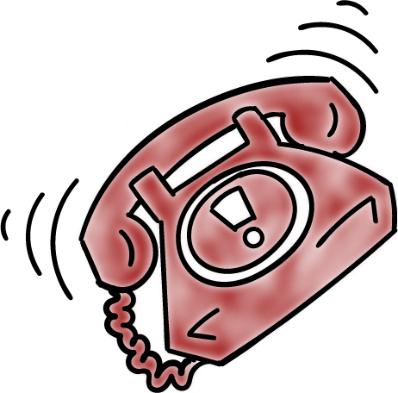
Secure OS Quiz #2
A system call allows application code to gain access to functionality implemented by the OS. A system call is often called a protected procedure call.
Is the cost of a system call:
the same as a regular call
higher than a regular call
Notes:
QUIZ:
A system call allows application code to gain access to functionality implemented by the OS. A system call is often called a protected procedure call.
Is the cost of a system call
☐ same
☐ higher than a regular call?
SOLUTION: Discuss

Slide 8
Secure OS Quiz #3
Complete mediation ensures that the OS cannot be bypassed when accessing a protected resource. How does the OS know who is making the request for the resource?
Process runs on behalf of a user who must have previously logged in,
Requested resource allows us to find out who must be requesting it
Notes:
QUIZ: Complete mediation ensures that the OS cannot be bypassed when accessing a protected resource. How does the OS know who is making the request for the resource?
☐Process runs on behalf of a user who must have previously logged in,
☐Requested resource allows us to find out who must be requesting it
SOLUTION: Discuss answers

Slide 9

Isolating OS from Untrusted User Code
How do we meet the first requirement of a TCB (e.g., isolation or tamper-proof)?
Hardware support for memory protection
Processor execution modes (system AND user modes, execution rings)
Privileged instructions which can only be executed in system mode
System calls used to transfer control between user and system code
Notes:
How do we meet the requirements of a TCB (e.g., isolation or tamper-proof)?
Hardware support for memory protection
Processor execution modes (system AND user modes, execution rings)
Privileged instructions which can only be executed in system mode
System calls used to transfer control between user and system code

Slide 10
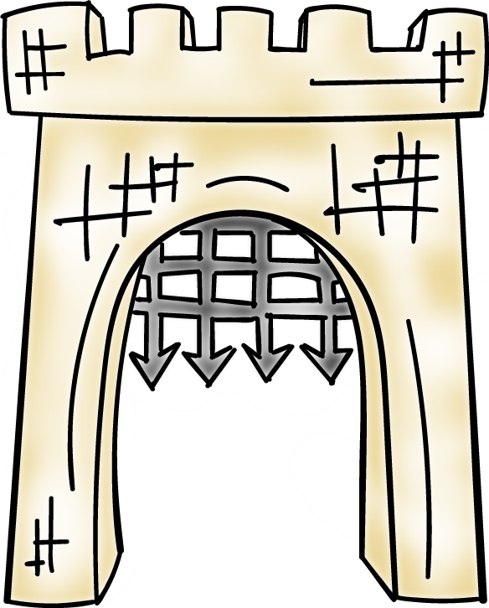
System Calls: Going from User to OS Code
System calls used to transfer control between user and system code
Such calls come through “call gates” and return back to user code. The processor execution mode or privilege ring changes when call and return happen.
x86 Sysenter/sysexit instructions
Notes:
Such calls come through “call gates” and return back to user code. The processor execution mode or privilege ring changes when call and return happen.

Slide 11
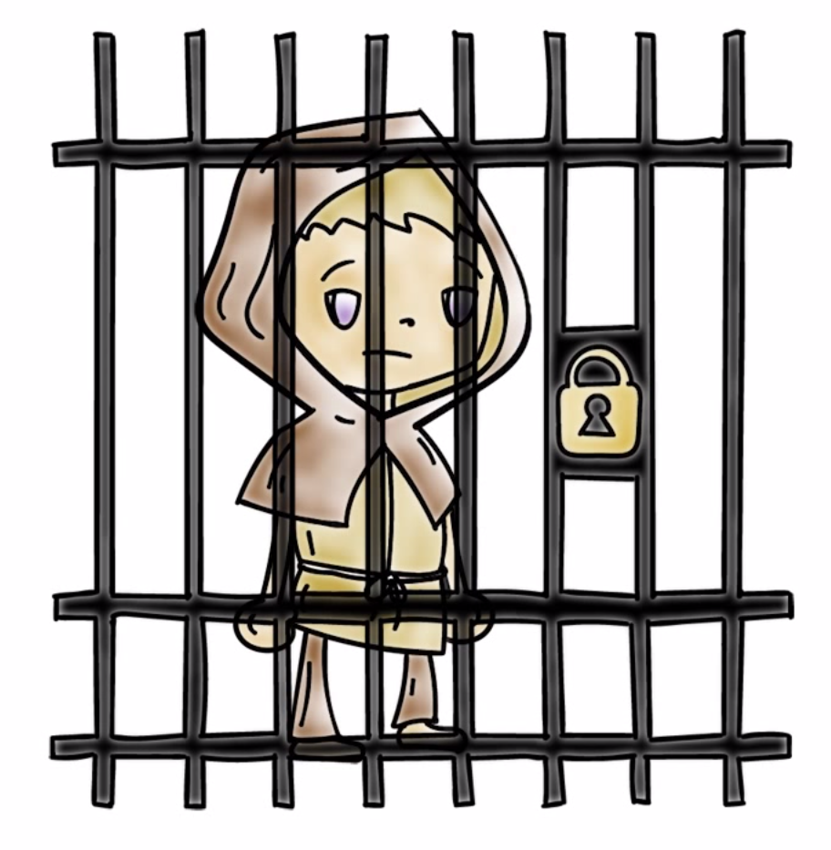
Isolating User Processes from Each Other
How do we meet the user/user isolation and separation?
OS uses hardware support for memory protection to ensure this.
Notes:
How do we meet the isolation OS/user isolation and separation?
Hardware support for memory protection.

Slide 12
Tampering with the OS Quiz
Which of these methods have been shown to allow hacker access to ‘secure’ memory belonging to the OS?
Modification of firmware by Thunderstrike malware via malicious devices that connect via Mac’s Thunderbolt interface
Exploiting the ‘refresh’ mechanism of a Dynamic RAM for privilege escalation
Exploiting OS code buffer overflow vulnerability
Notes:
QUIZ: Before we discuss how to isolate the memory from the user. Let’s get into a Security Mindset …
Think of ways a hacker can access memory.
SOLUTION: The first two answers have both been shown to allow unauthorized access to memory.
There are links in the instructors notes with more information.
First is BadUSB hack, changes firmware which can take over a computer, modifying key OS data structures. BlackHat
Thunderstrike at http://arstechnica.com/security/2015/01/worlds-first-known-bootkit-for-os-x-can-permanently-backdoor-macs/
Row hammer hack http://googleprojectzero.blogspot.com/2015/03/exploiting-dram-rowhammer-bug-to-gain.htm

Slide 13
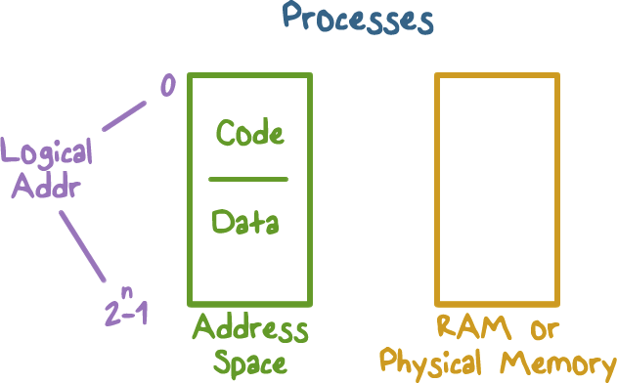
Address Space: Unit of Isolation
Processes view memory as contiguous often larger than available physical memory
Usually 2³² or 2⁶⁴ addresses
Each process has its own mapping
Notes:
Discuss the logical address mapping to the physical memory.
Every process views memory as contiguous, often larger than available physical memory.
Usually 2^32 or 2^64 addresses
Each process has its own mapping

Slide 14
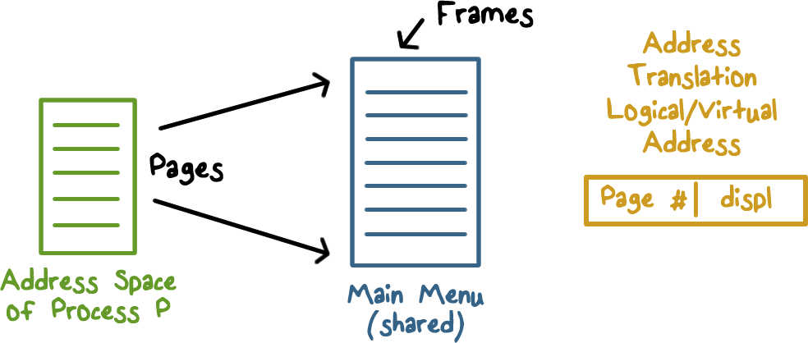
Address Translation
Operating system maps logical virtual addresses or pages onto physical memory frames
Notes:
Operating system maps logical virtual addresses or pages onto physical memory frames

Slide 15
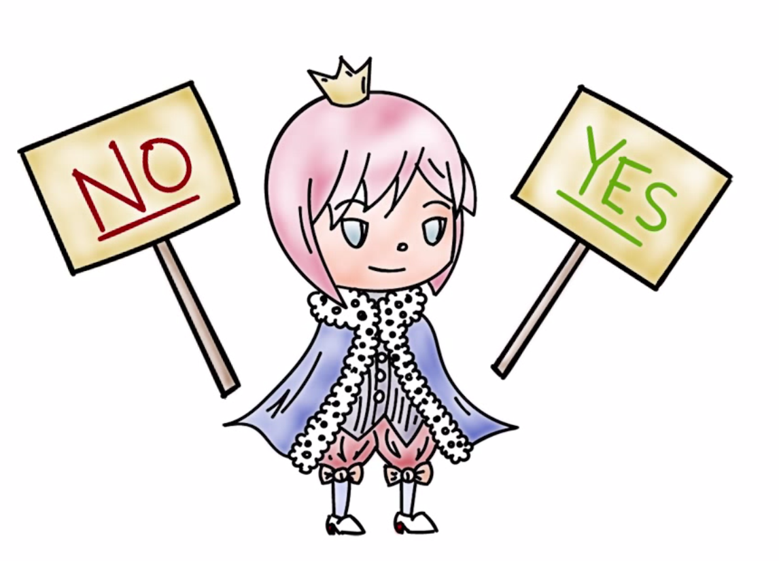
Process Data/Code Protection
OS will not map a virtual page of process A to a physical page of process B unless explicit sharing is desired.
Process A cannot access process B’s memory because it has no way to name/reach its memory.
Page tables managed by OS
Notes:
OS will not map a virtual page of process A to a physical page of process B unless explicit sharing is desired.
Process A cannot access process B’s memory because it has not way to name/reach its memory.
Page tables managed by OS

Slide 16
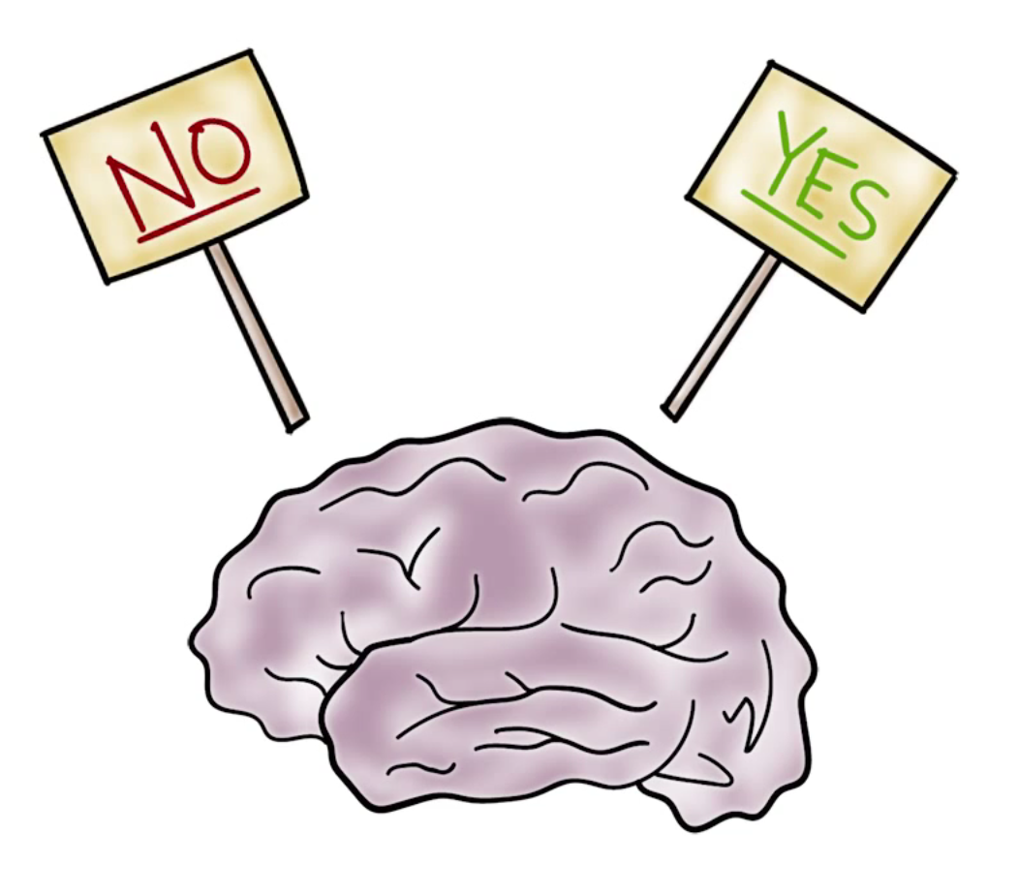
Process Protection
through Memory Management
Processor memory management unit (MMU) uses page tables to resolve virtual addresses to physical addresses.
RWX bits on pages limit type of access to addressable memory
Notes:
Processor memory management unit (MMU) uses page tables to resolve virtual addresses to physical addresses.
RWX bits on pages limit type of access to addressable memory

Slide 17
Revisiting Stack Overflow Quiz
The stack can be exploited through:
Overflowing the buffer to change the return address to alter program execution
Pushing data onto the stack to overflow the stack into the heap
Popping data off the stack to gain access to application code.
Notes:
QUIZ: Before we discuss how to create a non-executable stack, let’s discuss the stack’s exploitable weaknesses.
SOLUTION: Discuss answers

Slide 18

Preventing Malicious Code Execution on the Stack through a Non-Executable Stack
Now think, how can we do a non-executable stack to help prevent code injection via stack buffer?
Used by Windows, OS X, Linux
Notes:
Now think how we can do a non-executable stack to help prevent code injection via stack buffer
Used by Windows, OS X, Linux

Slide 19
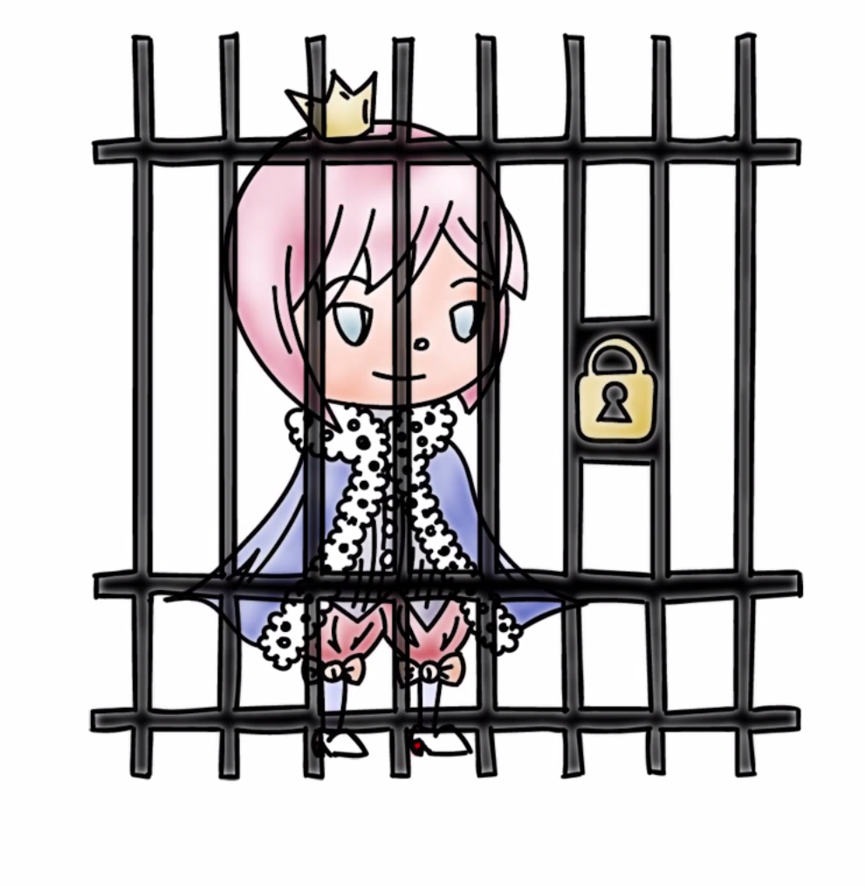
OS Isolation from Application Code
OS (Kernel) resides in a portion of each process’s address space.
True for each process, processes can cross the fence only in controlled/limited ways.
Notes:
Some more details for isolation of OS from application code.
OS (Kernel) resides in a portion of each process’s address space.
True for each process, processes can cross the fence only in controlled/limited ways.

Slide 20
OS Isolation from Application Code
Linux, DOS, OS X
32-bit Linux: Lower 3GB for user code/data, top 1GB for kernel
Corresponds to x86 privilege ring transitions
Windows and OS X similar
DOS had no such fence, any process could alter DOS and viruses could spread by hooking DOS interrupt handlers via kernel changes
Notes:
32-bit Linux: Lower 3GB for process, top 1GB for kernel
Corresponds to x86 privilege ring transitions
Windows and OS X similar
DOS had no such fence, any process could alter DOS and viruses could spread by hooking DOS interrupt handlers via kernel changes

Slide 21
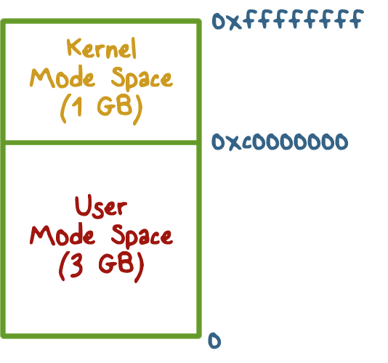

Linux User/Kernel Memory Split
Notes:
Discuss the illustration

Slide 22
Execution Privilege Level Quiz
For the following described functions, Should it be executed in the operating system or if it can be executed in application code running in user mode?
OS
User
Switching CPU from one process to another when a process blocks.
Page fault handling
Changing who can access a protected resource such as a file
Setting up a new stack frame when an application program calls one of its functions
Notes:
QUIZ: For the following described function, should it be executed in the operating system or user if it can be executed in application code.
Switching CPU from one process to another when a process blocks.
Page fault handling
Changing who can access a protected resource such as a file
Setting up a new stack frame when an application program calls one of its functions
SOLUTION: Discuss answers

Slide 23
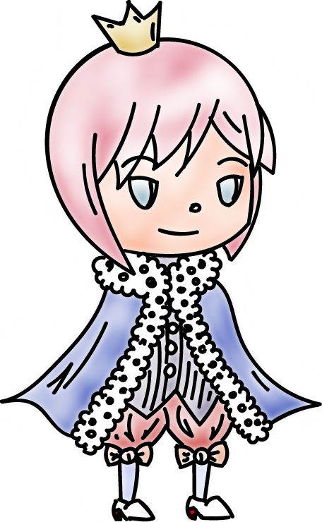
Complete Mediation:
The TCB
Make sure that no protected resource (e.g., memory page or file) could be accessed without going through the TCB
TCB acts as a reference monitor that cannot be bypassed
Privileged instructions
Notes:
Complete Mediation
Make sure that no protected resource (e.g., memory page or file) could be accessed without going through the TCB
TCB acts as a reference monitor that cannot be bypassed

Slide 24

Complete Mediation:
User Code
User code cannot access OS part of address space without changing to system mode
User code cannot access physical resources because they require privileged instructions (e.g. servicing interrupts) which can only be executed in system mode
Notes:
User code cannot access OS part of address space without changing to system mode
User code cannot access physical resources because they require privileged instructions (e.g. servicing interrupts) which can only be executed in system mode

Slide 25
Complete Mediation:
OS
OS virtualizes physical resources and provides an API for virtualized resources
File for storing persistent data on disk
Virtual resource must be translated to physical resource handle (e.g., file buffers) which can only be done by OS, which ensures complete mediation
Notes:
OS virtualizes physical resources and provides an API for the virtualized resources
File for storing persistent data on disk
Virtual resource must be translated to physical resource handle (e.g., file buffers) which can only be done by OS, which ensures complete mediation

Slide 26
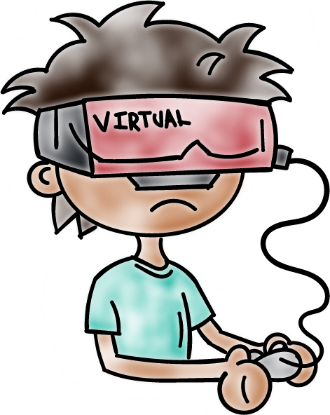
Virtualization
OS is large and complex, even different operating systems may be desired by different customers
Compromise of an OS impacts all applications
Notes:
Virtualization is used in Cloud computing systems. Let us discuss some security aspects of it.
OS is large and complex, even different operating systems may be desired by different customers
Compromise of an OS impacts all applications

Slide 27

Limiting the Damage of a Hacked OS
Use: Hypervisor, virtual machines, guest OS and applications
Compromise of OS in VM1 only impacts applications running on VM1
Notes:
Can we limit/contain harm done by OS running some application?
Hypervisor, virtual machines, guest OS and applications
Compromise of OS in VM1 only impacts applications running on VM2

Slide 28
Limiting the Damage of a Hacked OS
Do your taxes in on VM1 while browsing potentially dangerous places on the web on VM2
What is the TCB here?
Hypervisor!
Notes:
Do your taxes in one VM while browsing potentially dangerous places on the web on VM2
What is the TCB here? Hypervisor!

Slide 29
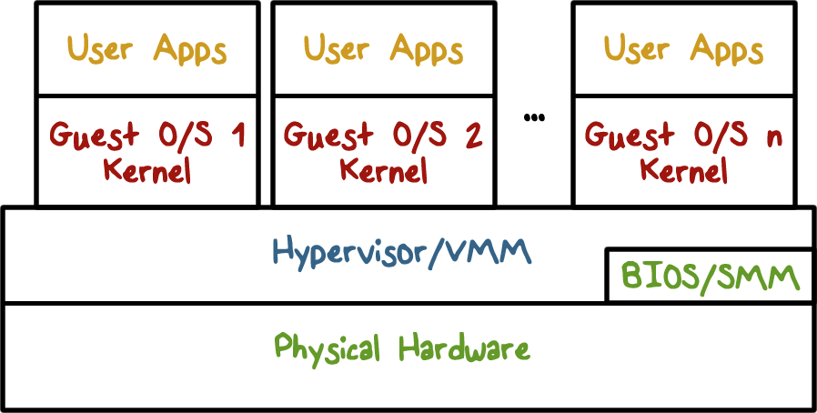
Virtualization Security Layers
Notes:
Discuss the security layers.

Slide 30

Correctness:
The Final TCB Requirement
Compromise of OS (TCB) means an attacker has access to everything.
Getting the TCB right is extremely important
Smaller and simpler (hypervisor only partitions physical resources among VMs and let us guest OS handle management)
Secure coding is really important when writing the OS which typically is written in languages that are not type safe
Notes:
orrectness – Final Requirement of TCB
Compromise of OS (TCB) means all bets are off, attacker has access to everything.
Getting the TCB is extremely important
Smaller and simpler (hypervisor only partitions physical resources among VMs and let us guest OS handle management)
Secure coding is really important when writing the OS which typically is written in languages that are not type safe
We will talk more about trustworthiness of TCB

Slide 31
TCB Requirements Quiz
An attack that exploits a vulnerability in an operating system turns off the check that is performed before access to a protected resource is granted.
What TCB requirement is violated as a result of this attack?
Complete mediation
Correctness
Tamper-proof
Notes:
QUIZ:
An attack that exploits a vulnerability in an operating system turns off the check that is performed before access to a protected resource is granted.
What TCB requirement is violated as a result of this attack?
☐ Complete mediation
☐ Correctness
☐ Tamper-proof SOLUTION:
Discuss answers

Slide 32
Size of Security Code Quiz
Going from MS DOS to recent Windows operating systems, what is a rough estimate for the multiplier for the lines of code (e.g. multiplier is x if recent Windows OS is x times the number of lines of code in DOS)?
Windows OS is 100x larger than MS DOS
Windows OS is 500x larger than MS DOS
Windows OS is 10,000x larger than MS DOS
Notes:
QUIZ:
Getting an OS correct is challenging because of its size which reflects complexity of its functions.
Going from MS DOS to recent Windows operating systems, what is a rough estimate for the multiplier for the lines of code (e.g. multiplier is x if recent Windows OS is x times the number of lines of code in DOS)?
☐ Windows OS is 100 x larger than MS DOS
☐ Windows OS is 500 x larger than MS DOS
☐ Windows OS is 2000 x larger than MS DOS SOLUTION:
Discuss -- MS DOS 1.0 4000 lines of assembler code

Slide 33

Hypervisor Code Size Quiz
The number of lines of code in a hypervisor is expected to be smaller. Xen is an open source hypervisor.
What is a rough estimate for the lines of code for the Xen hypervisor?
10,000
150,000
1,000,000
Notes:
QUIZ: The number of lines of code in a hypervisor is expected to be smaller. Xen is an open source hypervisor. What is a rough estimate for the lines of code for hypervisor? ☐ 10,000 ☐ 150,000 ☐ 1,000,000
SOLUTION:
Discuss

Slide 34
Operating Systems Security
Lesson Summary
Understand the important role an OS plays in protecting resources and applications
Understand how OS is isolated from untrusted code with hardware support for memory management
Understand how complete mediation is provided.
Notes:
Headshot

